Slide 1

Thinksoft Research and Information Technologies
Shwetha A
BE(ECE),M.Tech.(DECS)
Senior Research Engineer
Email: info@thinksciences.org, Website: www.thinksciences.or
Notes:
Introduction to Matlab

Slide 2

Stands for MATrix LABoratory
Interpreted language
Scientific programming environment
Very good tool for the manipulation of matrices
Great visualisation capabilities
Loads of built-in functions
Easy to learn and simple to use
Email: info@thinksciences.org, Website: www.thinksciences.or Shwetha A

Slide 3

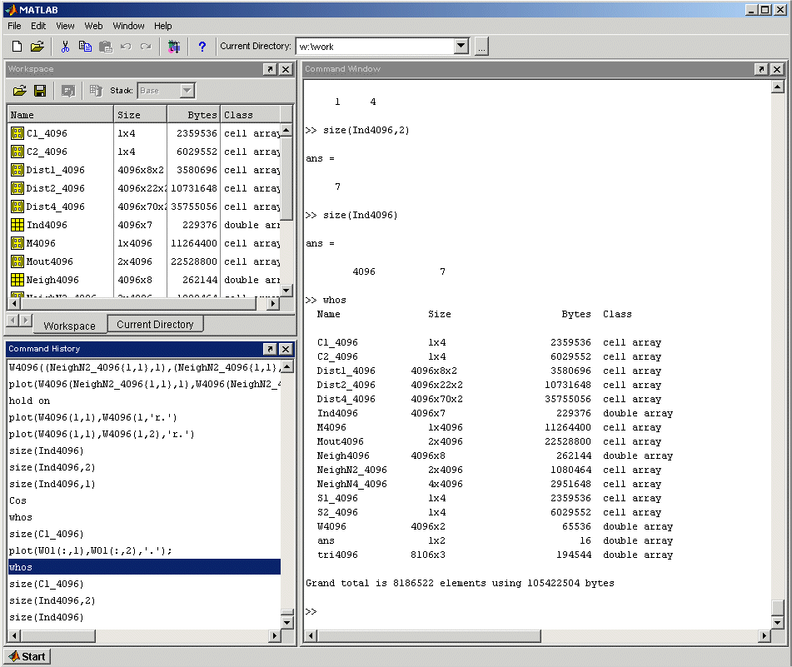

Workspace / Current Directory
Command Window
Command History
Explore the Matlab Desktop
Email: info@thinksciences.org, Website: www.thinksciences.or Shwetha A

Slide 4
Don’t have to declare type
Don’t even have to initialise
Just assign in command window
>>
>> a=12; % variable a is assigned 12
Matlab prompt
comment operator
suppress command output
assign operator
Try the same line without the semicolon and comments
Email: info@thinksciences.org, Website: www.thinksciences.or Shwetha A

Slide 5

View variable contents by simply typing the variable name at the command prompt
>> a
a =
12
>>
>> a*2
a =
24
>>
Email: info@thinksciences.org, Website: www.thinksciences.or Shwetha A

Slide 6

The workspace is Matlab’s memory
Can manipulate variables stored in the workspace
>> b=10;
>> c=a+b
c =
22
>>
Email: info@thinksciences.org, Website: www.thinksciences.or Shwetha A

Slide 7

Display contents of workspace
>> whos
Name Size Bytes Class
a 1x1 8 double array
b 1x1 8 double array
c 1x1 8 double array
Grand total is 3 elements using 24 bytes
>>
Delete variable(s) from workspace
>> clear a b; % delete a and b from workspace
>> whos
>> clear all; % delete all variables from workspace
>> whos
Email: info@thinksciences.org, Website: www.thinksciences.or Shwetha A

Slide 8

help
>> help whos % displays documentation for the function whos
>> lookfor convert % displays functions with convert in the first help line
Start Matlab help documentation
>> helpdesk
Email: info@thinksciences.org, Website: www.thinksciences.or Shwetha A

Slide 9

Don’t need to initialise type, or dimensions
>>A = [3 2 1; 5 1 0; 2 1 7]
A =
3 2 1
5 1 0
2 1 7
>>
square brackets to define matrices
semicolon for next row in matrix
Email: info@thinksciences.org, Website: www.thinksciences.or Shwetha A

Slide 10

A =
3 2 1
5 1 0
2 1 7
Access elements of a matrix
>>A(1,2)
ans=
2
Remember Matrix(row,column)
Naming convention Matrix variables start with a capital letter while vectors or scalar variables start with a simple letter
indices of matrix element(s)
Email: info@thinksciences.org, Website: www.thinksciences.or Shwetha A

Slide 11

VERY important operator in Matlab
Means ‘to’
>> 1:10
ans =
1 2 3 4 5 6 7 8 9 10
>> 1:2:10
ans =
1 3 5 7 9
Try the following
>> x=0:pi/12:2*pi;
>> y=sin(x)
Email: info@thinksciences.org, Website: www.thinksciences.or Shwetha A

Slide 12

>>A(3,2:3)
ans =
1 7
>>A(:,2)
ans =
2
1
1
A =
3 2 1
5 1 0
2 1 7
What’ll happen if you type A(:,:) ?
Email: info@thinksciences.org, Website: www.thinksciences.or Shwetha A

Slide 13
A =
3 2 1
5 1 0
2 1 7
B =
1 3 1
4 9 5
2 7 2
>> A ' % transpose
>> B*A % matrix multiplication
>> B.*A % element by element multiplication
>> B/A % matrix division
>> B./A % element by element division
>> [B A] % Join matrices (horizontally)
>> [B; A] % Join matrices (vertically)
Enter matrix B into the Matlab workspace
Create matrices A and B and try out the the matrix operators in this slide
Email: info@thinksciences.org, Website: www.thinksciences.or Shwetha A

Slide 14

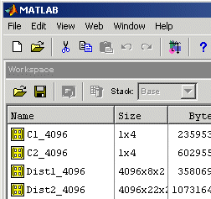
Matlab editor
Use scripts to execute a series of Matlab commands
Matlab Desktop
Press to create new m-file in the Matlab editor
Email: info@thinksciences.org, Website: www.thinksciences.or Shwetha A

Slide 15

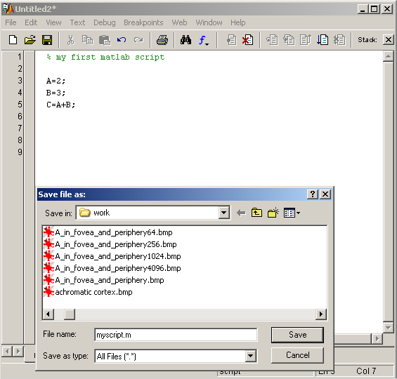
Scripts will manipulate and store variables and matrices in the Matlab Workspace (memory).
They can be called from the Matlab command line by typing the (case sensitive!) filename of the script file.
>> myscript
Scripts can be opened in the editor by the following
>> open myscript
Will be slightly different in Linux
Highlight a few lines of your script by left- clicking and dragging the mouse over the lines. Right-click the highlighted lines and select Evaluate Selection.
Email: info@thinksciences.org, Website: www.thinksciences.or Shwetha A

Slide 16

Programming in Matlab.
Users can write functions which can be called from the command line.
Functions can accept input variable(s)/matrice(s) and will output variable(s)/matrice(s).
Functions will not manipulate variable(s)/matrice(s) in the Matlab Workspace.
In Matlab functions closely resemble scripts and can be written in the Matlab editor. Matlab functions have the function keyword.
Remember that the filename of a function will be its calling function name.
Don’t overload any built-in functions by using the same filename for your functions or scripts!
Functions can be opened for editing using the open command. Many built-in Matlab functions can also be viewed using this command.
Email: info@thinksciences.org, Website: www.thinksciences.or Shwetha A

Slide 17

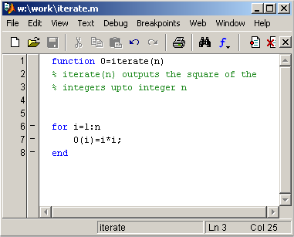
function name
input
>> I=iterate(5)
I =
1 4 9 16 25
output
function keyword
help lines for function
for statement block
Access the comments of your Matlab functions
>> help iterate
Make sure you save changes to the m-file before you call the function!
Email: info@thinksciences.org, Website: www.thinksciences.or Shwetha A

Slide 18
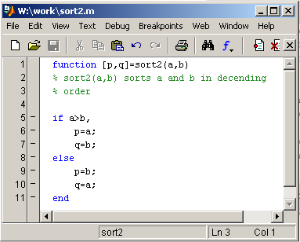
Functions can have many outputs contained in a matrix
>> [i j]=sort2(2,4)
i =
4
j =
2
>>
if statement block
Remember to use the Matlab help command for syntax
>> help if
Email: info@thinksciences.org, Website: www.thinksciences.or Shwetha A

Slide 19

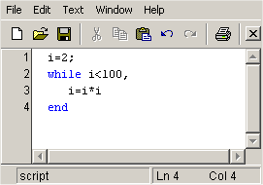
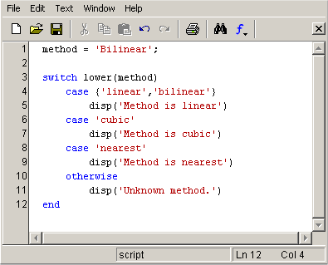
While statement block
Switch statement block
Without ; to print output
i =
4
i =
16
i =
256
Method is linear
>>
Email: info@thinksciences.org, Website: www.thinksciences.or Shwetha A

Slide 20

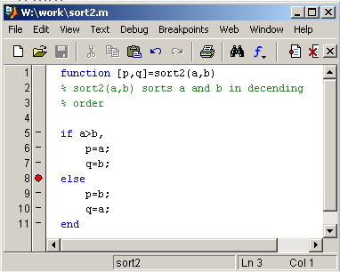
Debug menus
Set breakpoints to stop the execution of code
>> [i j]=sort2(2,4)
K>>
K>> whos
Name Size Bytes Class
a 1x1 8 double array
b 1x1 8 double array
Grand total is 2 elements using 16 bytes
K>> a
a =
2
K>> return
i =
4
j =
2
local function workspace
exit debug mode
Click mouse on the left of the line of code to create a breakpoint
Email: info@thinksciences.org, Website: www.thinksciences.or Shwetha A

Slide 21

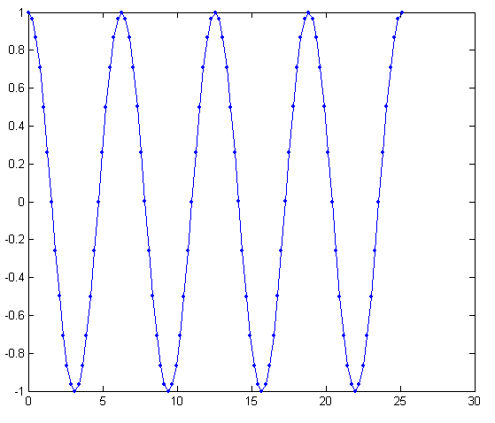
>> figure % create new figure
>> t=0:pi/12:8*pi;
>> y=cos(t);
>> plot(t,y,‘b.-')
Plot style
Investigate the function
>> y=A*cos(w*t+phi);
for different values of phi (eg: 0, pi/4, pi/3, pi/2), w (eg: 1, 2, 3, 4) and A (eg: 1, 0.5, 2). Use the hold on Matlab command to display your plots in the same figure. Remember to type hold off to go back to normal plotting mode. Try using different plot styles (help plot)
A = amplitude
phi = phase
w = angular frequency = 2*pi*frequency
Email: info@thinksciences.org, Website: www.thinksciences.or Shwetha A

Slide 22


2D-plotting
3D-plotting
Email: info@thinksciences.org, Website: www.thinksciences.or Shwetha A

Slide 23
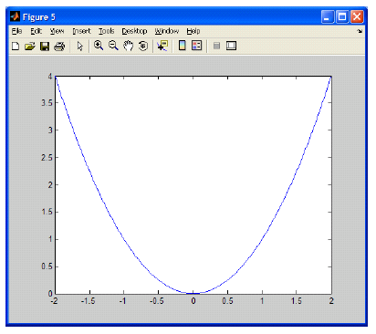



2D-plotting
Email: info@thinksciences.org, Website: www.thinksciences.or Shwetha A

Slide 24
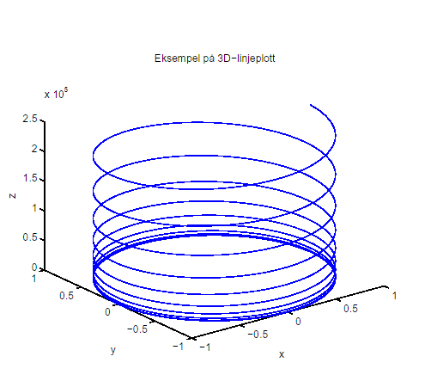
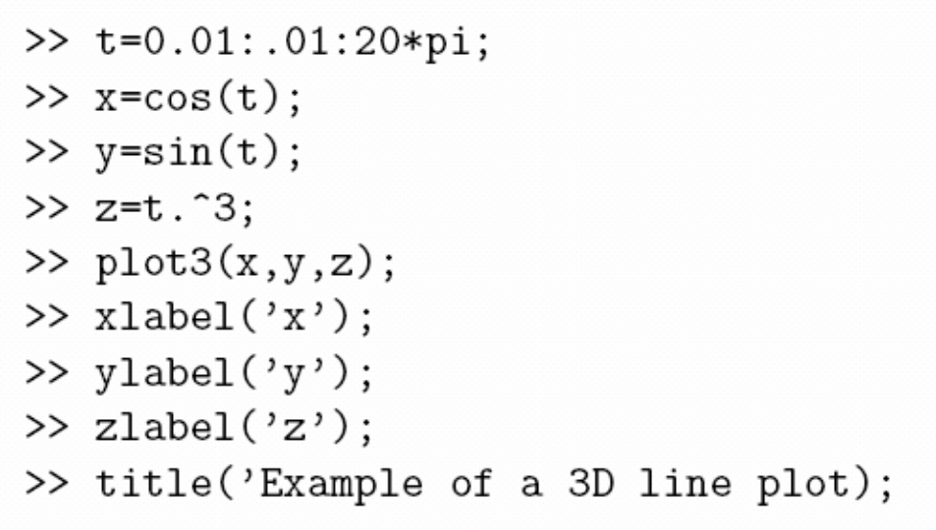
3D-plotting
Email: info@thinksciences.org, Website: www.thinksciences.or Shwetha A

Slide 25
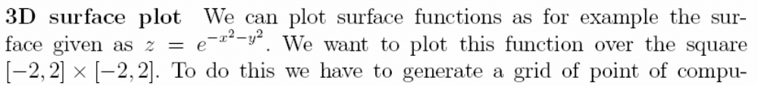

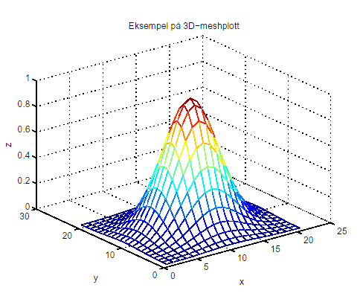

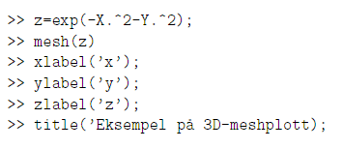
3D-plotting
Email: info@thinksciences.org, Website: www.thinksciences.or Shwetha A

Slide 26

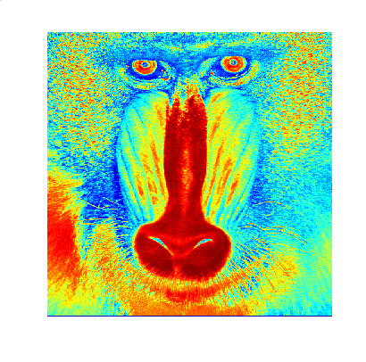
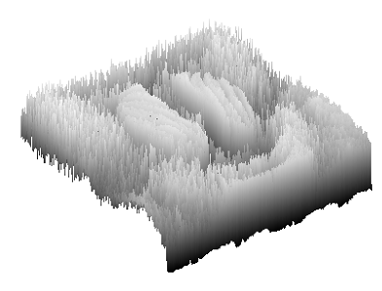
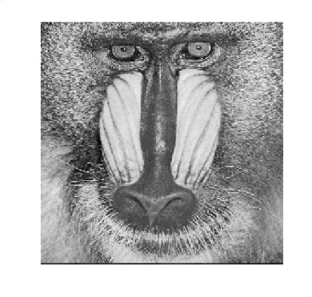
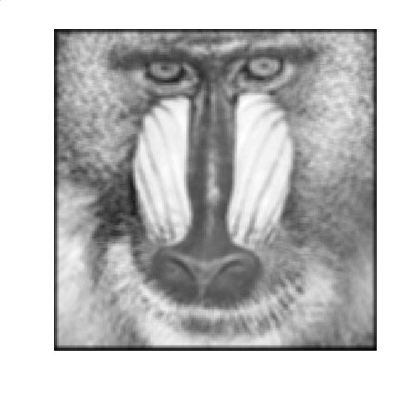
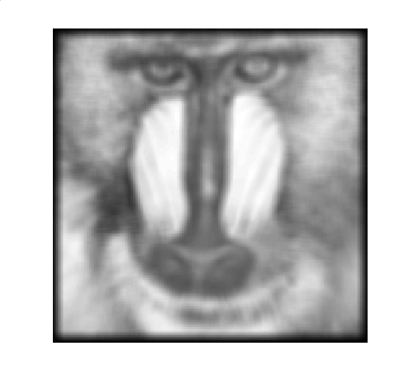


Next week …
Email: info@thinksciences.org, Website: www.thinksciences.or Shwetha A

Slide 27


< ¦ save !
> rand load guide
~= zeros … get
== min ' ' set
>= max { }
<= repmat try
& axis catch
Operating system command
Continue in next line
Graphical user interface
string
cell
error handling
Remember to use the Matlab help command if you get stuck
Email: info@thinksciences.org, Website: www.thinksciences.or Shwetha A

